Slide 1
Video Stabilization
Motivation: Videos captured by hand-held mobile devices often suffer from severe vibration due to the instable lens. Current solution for video stabilization is based on optical image stabilization (OIS), which requires expensive hardware to implement. A zero-cost algorithm for video stabilization is thus proposed in this project.

Slide 2
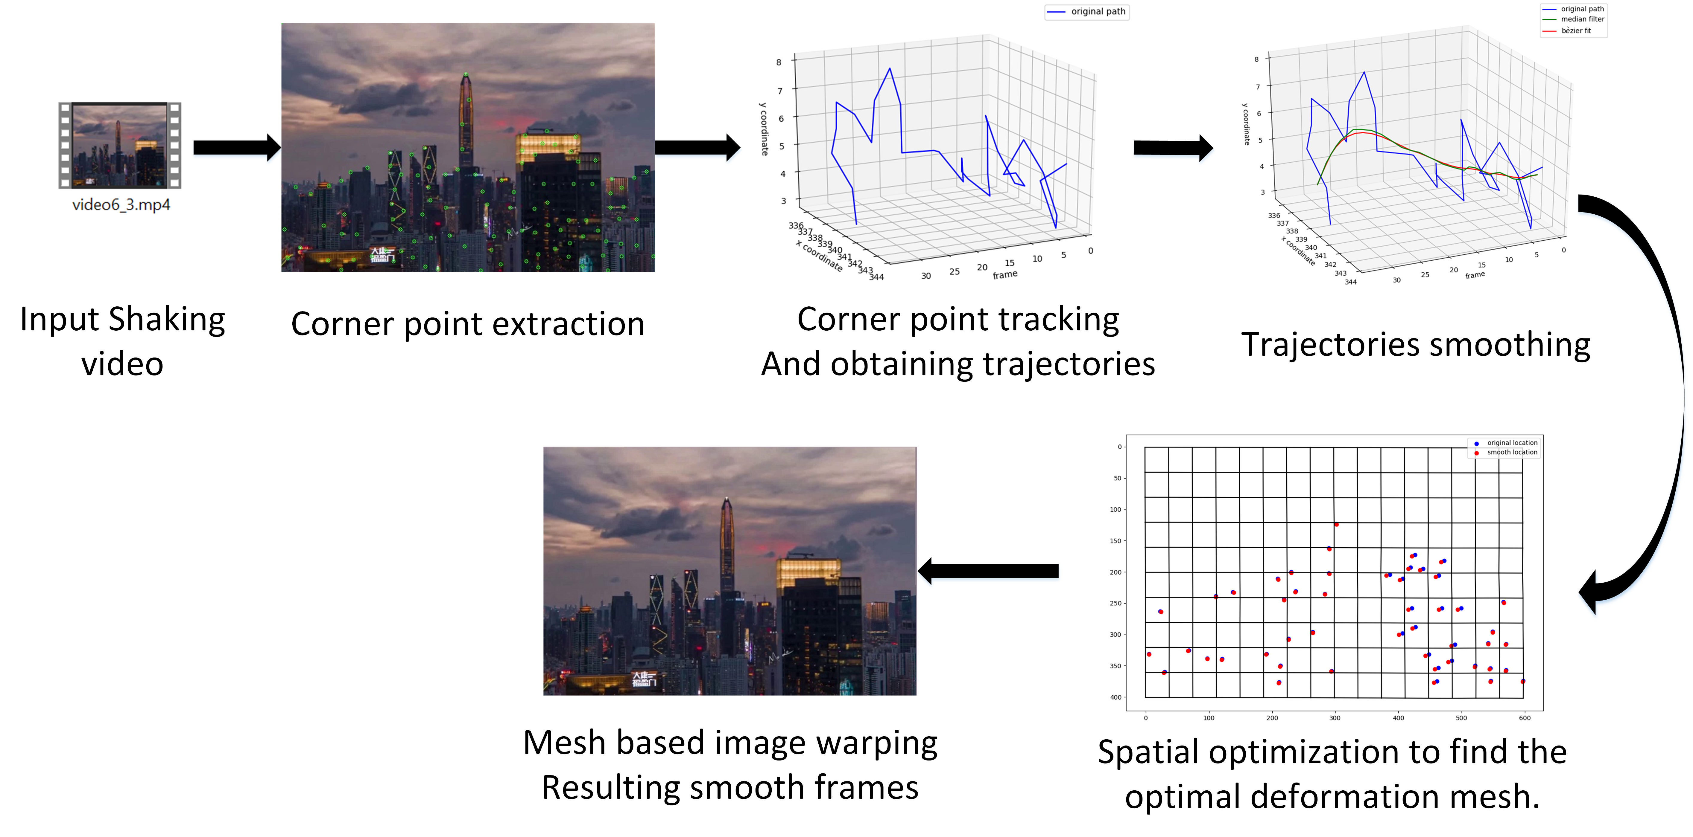
Goal and Methodology
Goal: Given a video suffering from severe vibration, the proposed method can output a stabilized version of the video.
Pipeline:

Slide 3
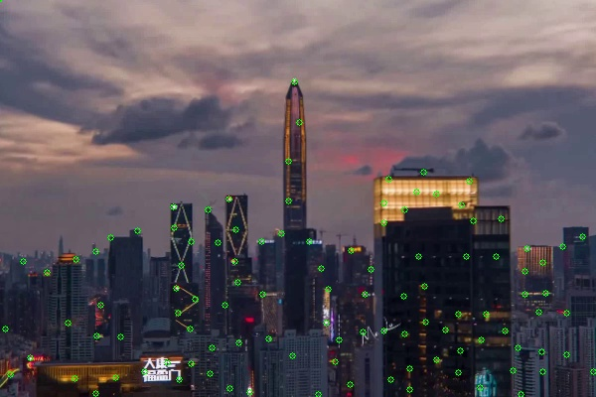
Methodology
1, Corner points detection using Harris detector
Corner points are detected and update every 5 frames, so that there should be sufficient amount of corner points throughout the whole video even if the lens is moving drastically.
Corner point extraction

Slide 4
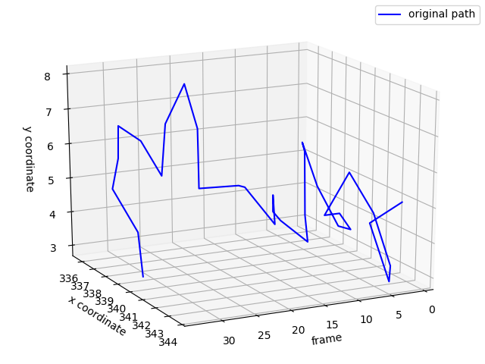
Methodology
2, Tracking the corner points’s movement using KLT algorithm.
Corner points location of a specific frame
Track the corner points’ movement from where it appears, and ends while the tracking is failed.

Slide 5
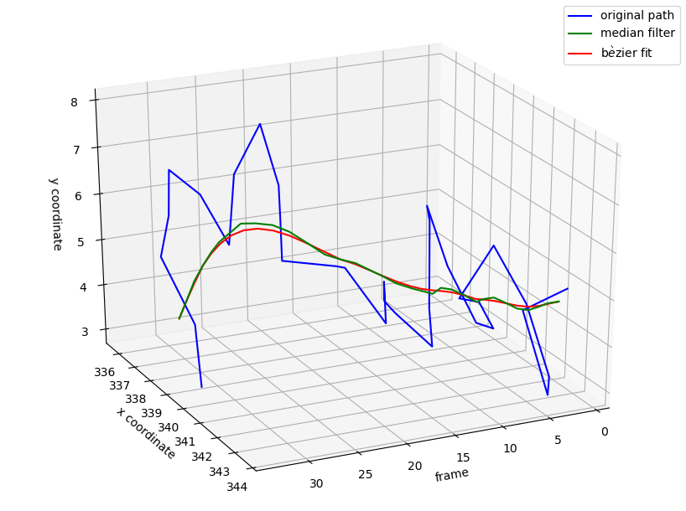
Methodology
3, Trajectories smoothing using median filter and Bezier curve fitting.
Result of Bezier fit has continuous curvature（卷度）.
Trajectories of a specific corner point.
Smooth trajectories.

Slide 6
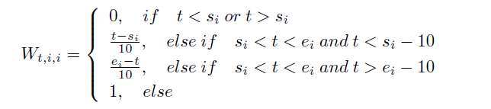
Methodology
4, Corner point significant values calculation.
Every 5 frames, new corner points will be added, or some corner points are failed to be tracked in the middle of the video. The sudden appearance and vanishment of a corner point would have significant influence to the image deformation results. Therefore, significant values are calculated in order to smooth the influence brought by the new incoming corner point.

Slide 7
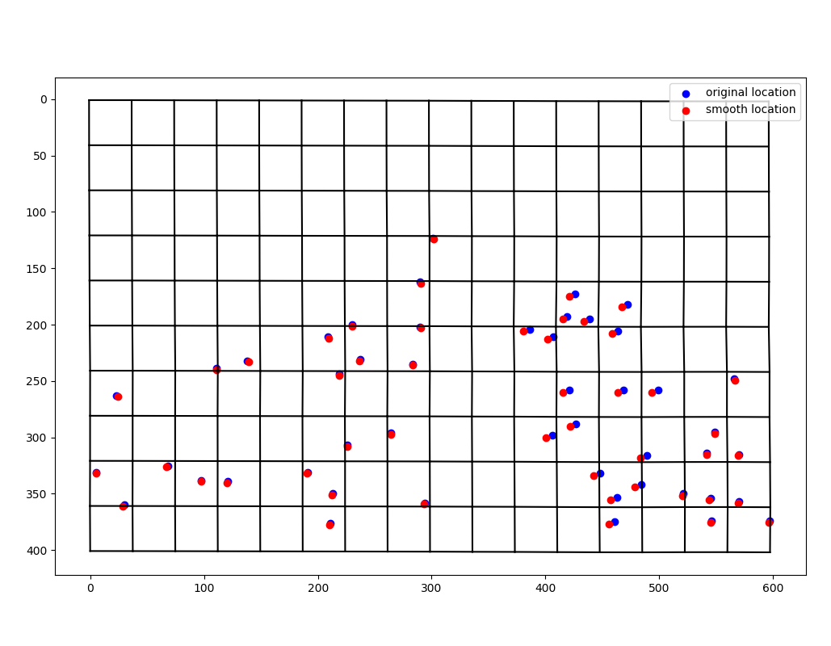
Methodology
5, Using non-linear optimization to generate the optimal deformation mesh.
Original and smooth trajectories.
Optimal deformation mesh.

Slide 8
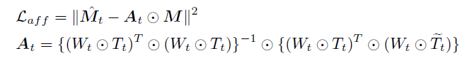
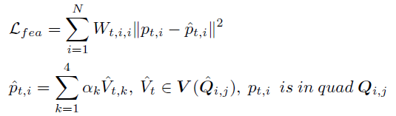
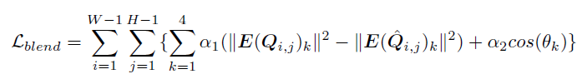
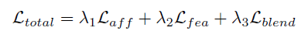
Methodology
5, Energy terms for the non-linear optimization.
Affine transformation energy:
Specify how far the deform mesh is away from a global affine deformation.
Feature displacement energy:
Specify how far the corner point in the deformed image is away from the smooth trajectory. Urge the resulting video to have smooth corner point trajectories.
Blending energy:
Smooth the deformation of the mesh, prevent image distortion.
Total energy:
Summing up the above three energies.

Slide 9

Methodology
6, Apply mesh-based image deformation to all the video frames.
Optimal deformation mesh a specific frame.
Deformation results of a specific frame.

